Slide 1


GRADUATION PROJECT

Slide 2
MEET OUR TEAM
1- abdelrahman sherif kamel
2- yossef mohamed mohamed
3- omnia ibrahim sayed

Slide 3
AGENDA
1- introduction
2- dashboard
3- telecom churn analysis
4- churn prediction

Slide 4
1- INTRODUCTION

Slide 5
ABOUT THE DATA
The data set includes information about:
Customers who left within the last month – the column is called Churn
Services that each customer has signed up for – phone, multiple lines, internet, online security, online backup, device protection, tech support, and streaming TV and movies
Customer account information – how long they’ve been a customer, contract, payment method, paperless billing, monthly charges, and total charges
Demographic info about customers – gender, age range, and if they have partners and dependents

Slide 6
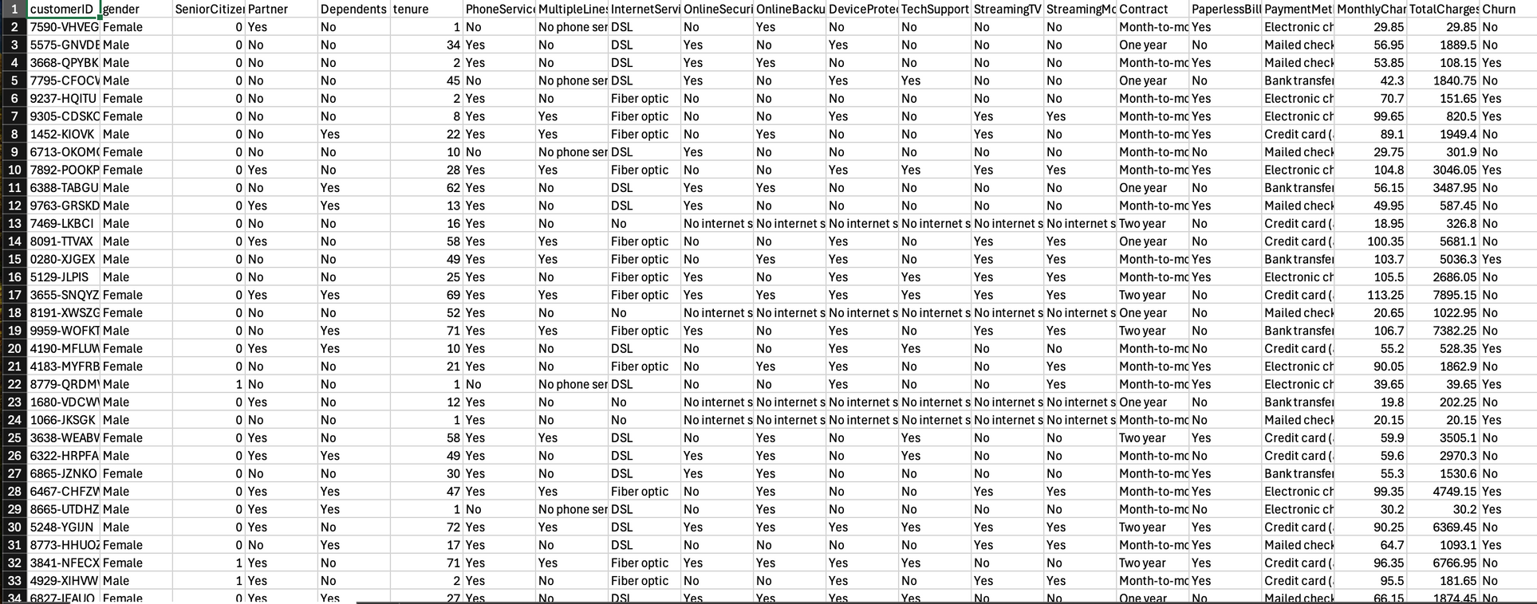
RAW DATA

Slide 7
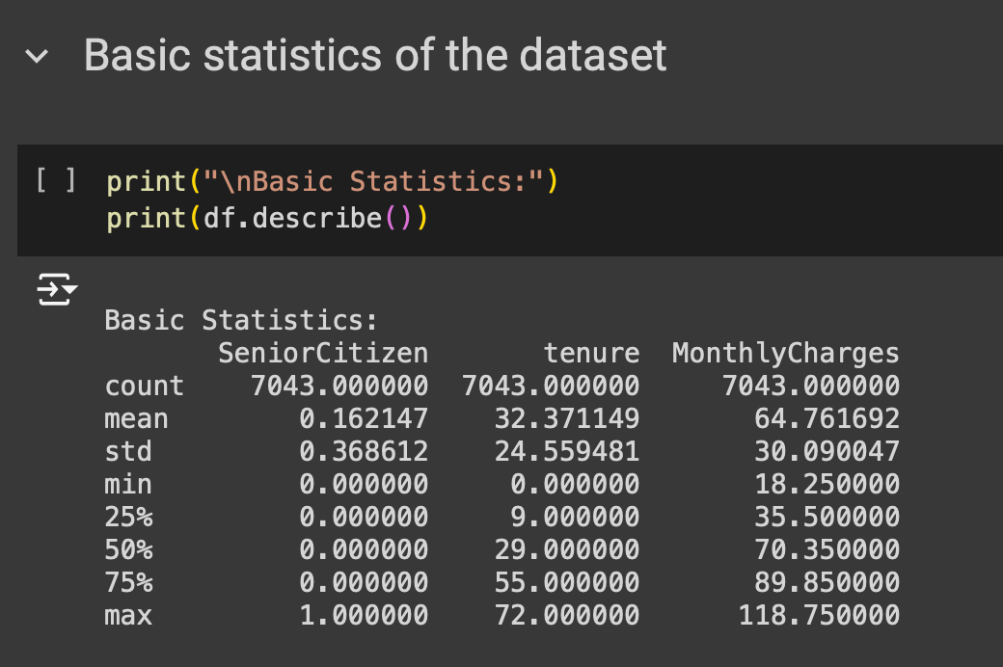
DATA PREPARATION
1- COLLECTION AND BASIC STATS

Slide 8
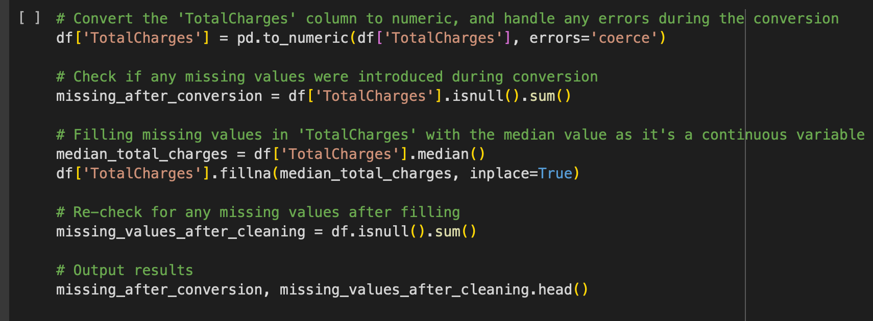
DATA PREPARATION
CONVERGEING TO NUMERIC VALUES

Slide 9
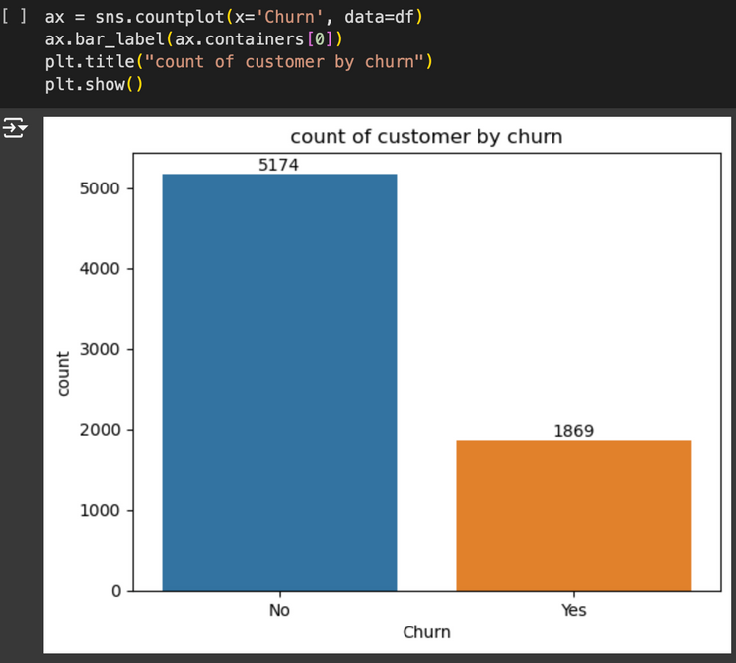
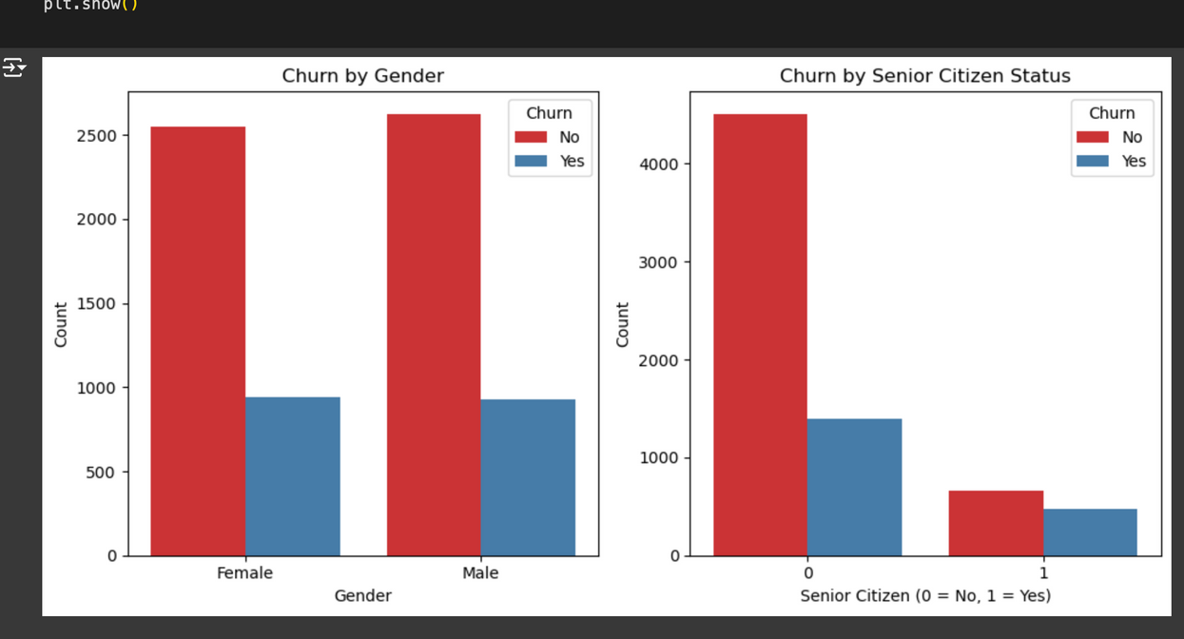
DATA PREPARATION
DATA UNDERSTANDING

Slide 10
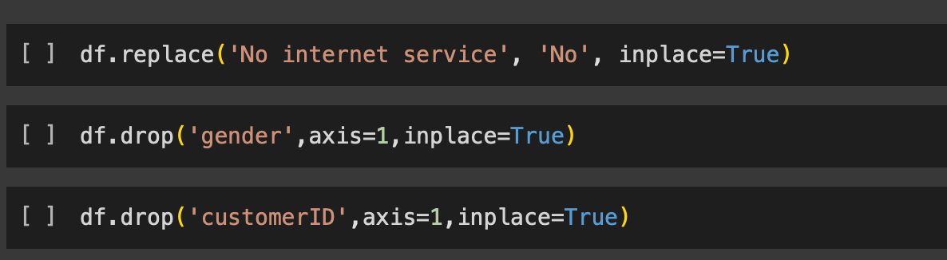
DATA PREPARATION
FEATURES SELECTION

Slide 11
2- DASHBOARD

Slide 12
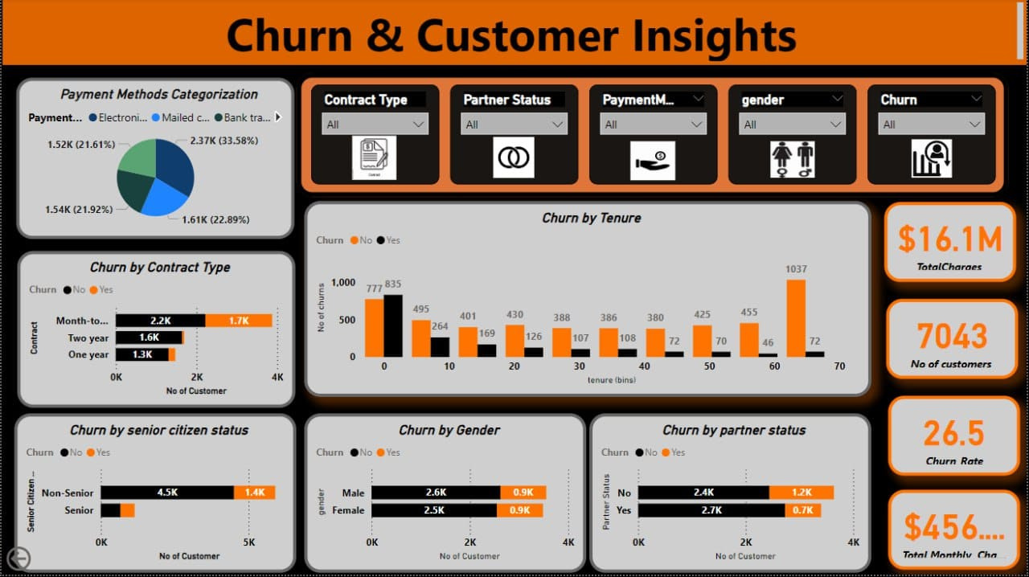

Slide 13
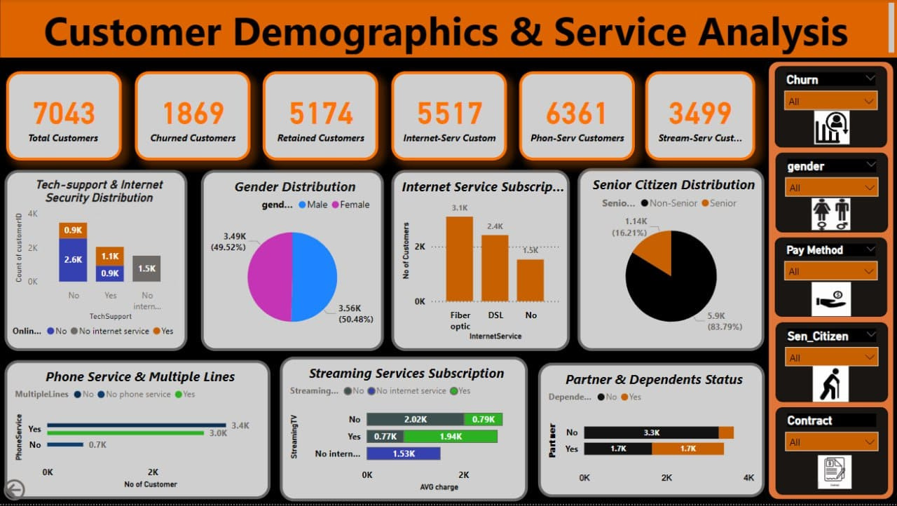

Slide 14
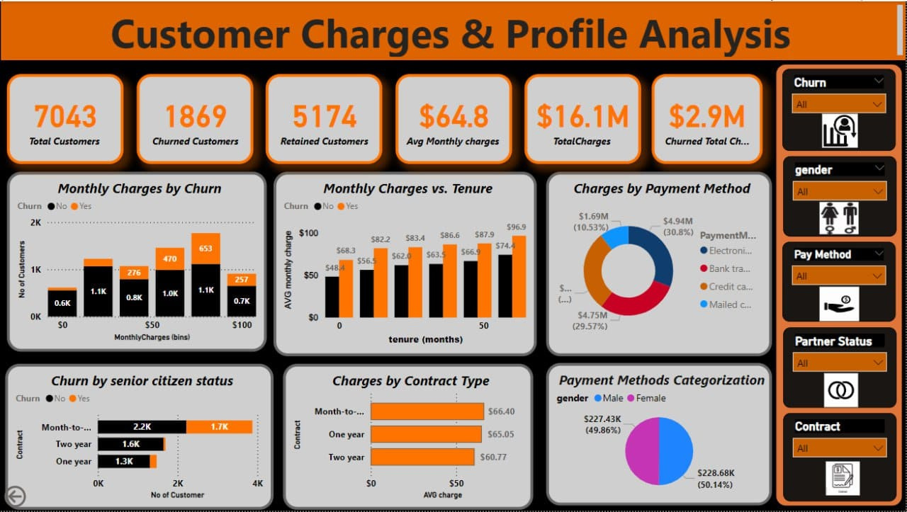

Slide 15
3- ANALYSIS

Slide 16

no. of churn customer is indicating that a noticeable number of customers may churn

Slide 17
i have then to know the gender and citizen ship of the customers

Slide 18
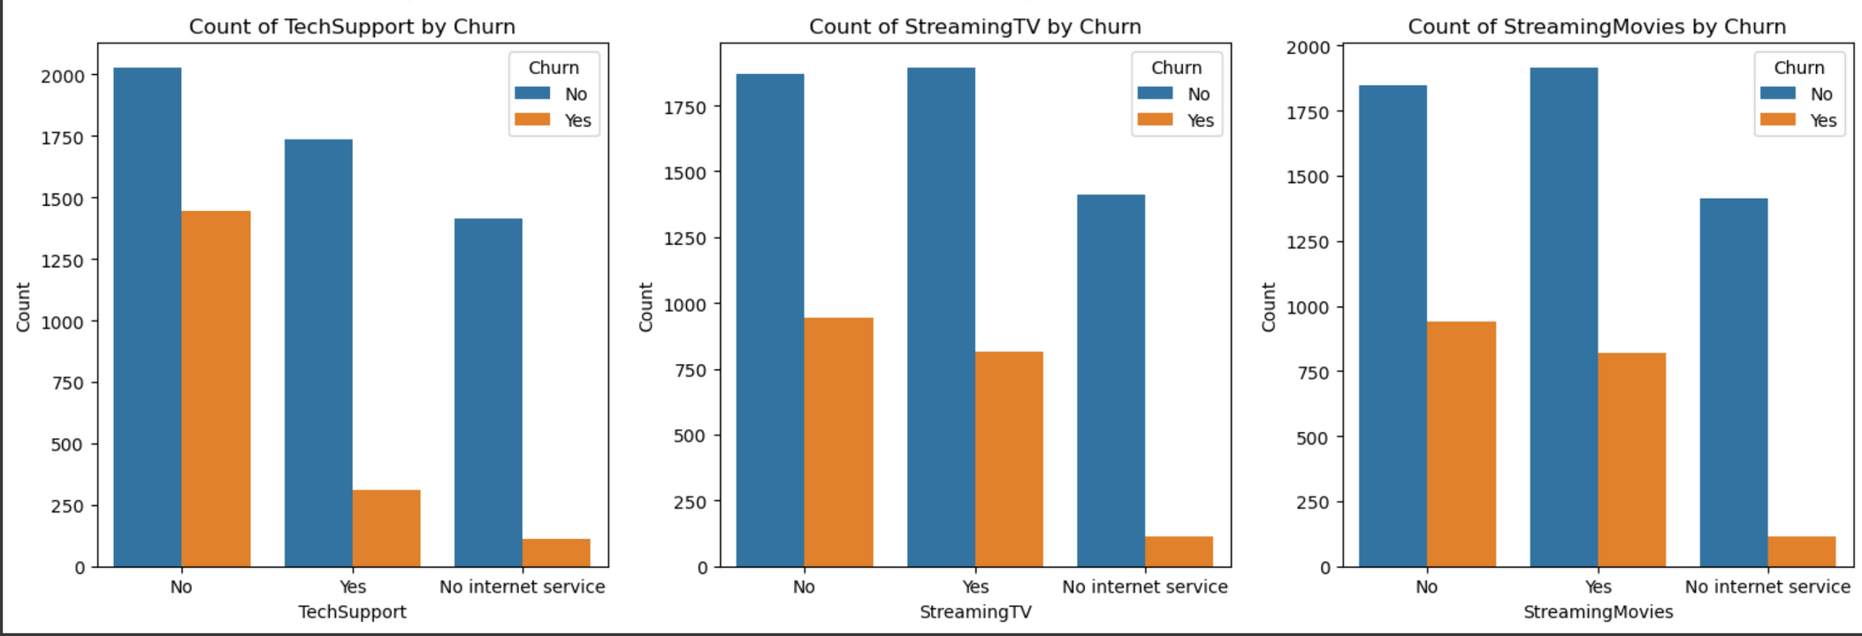

Slide 19
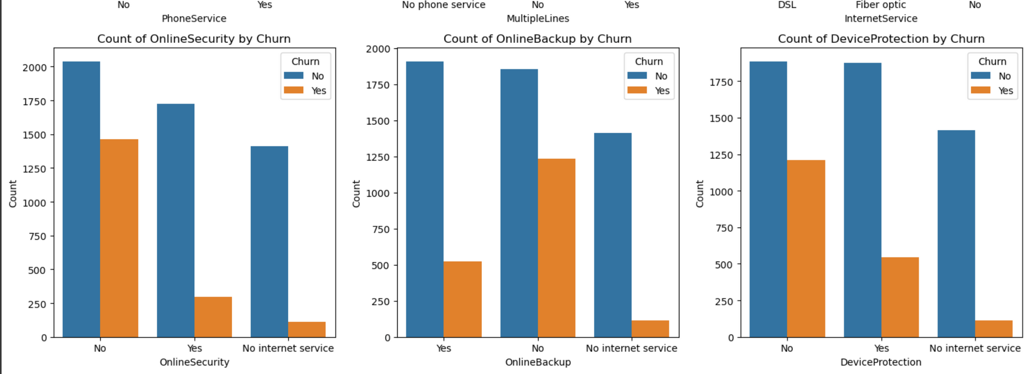

Slide 20
4- PREDICTION

Slide 21
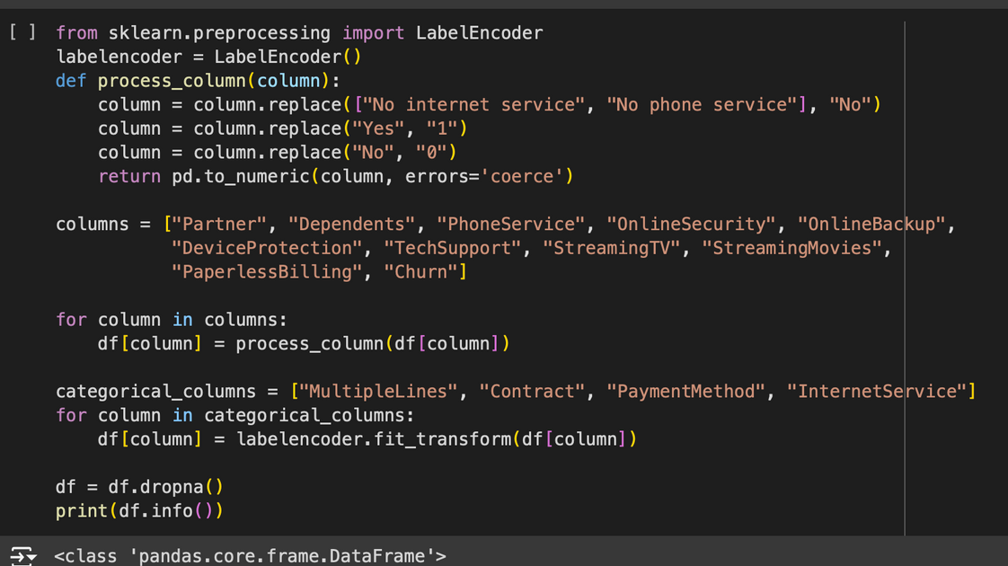
DATA REMODELING
ENCODING

Slide 22
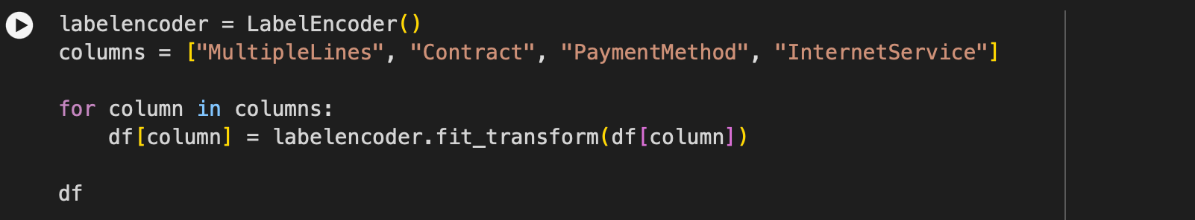
DATA REMODELING
ENCODING

Slide 23
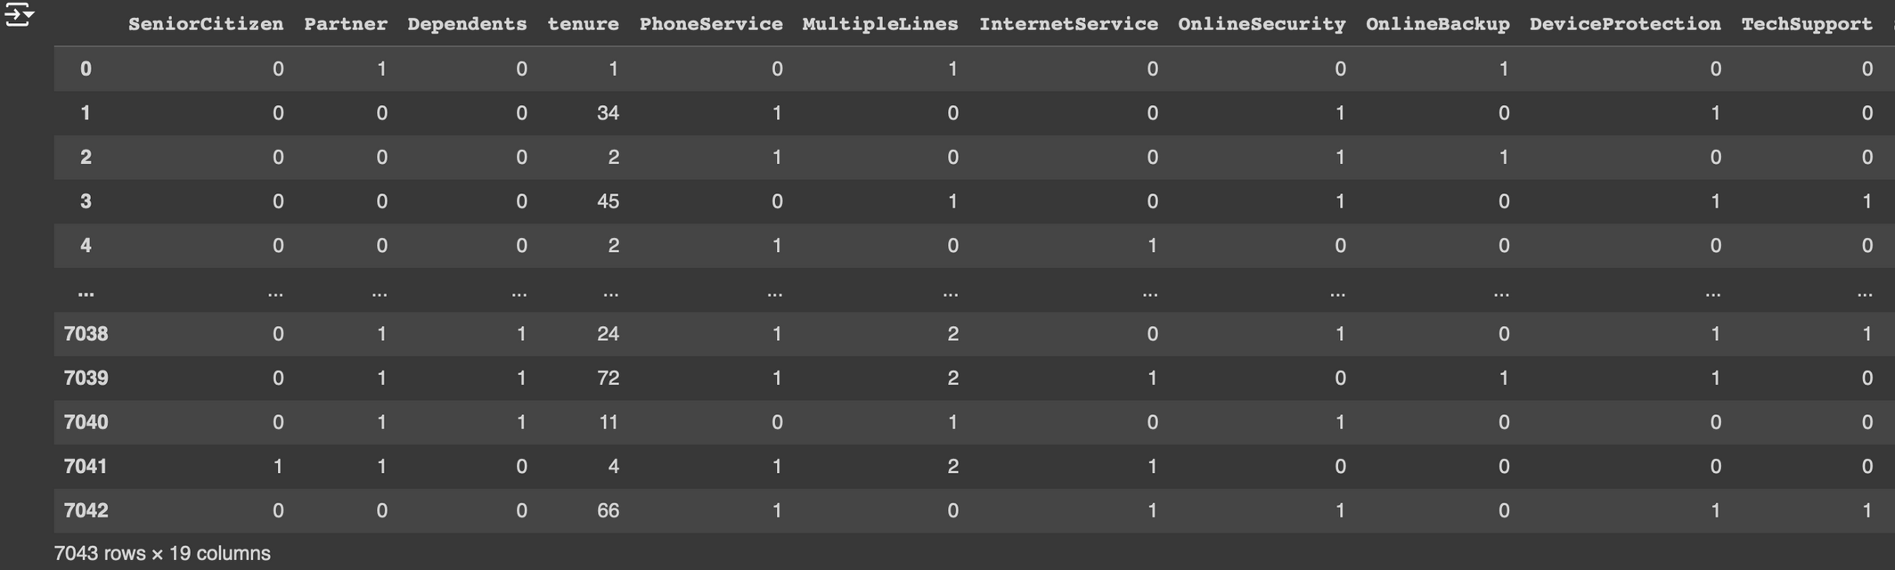
BUILDING THE MODEL

Slide 24
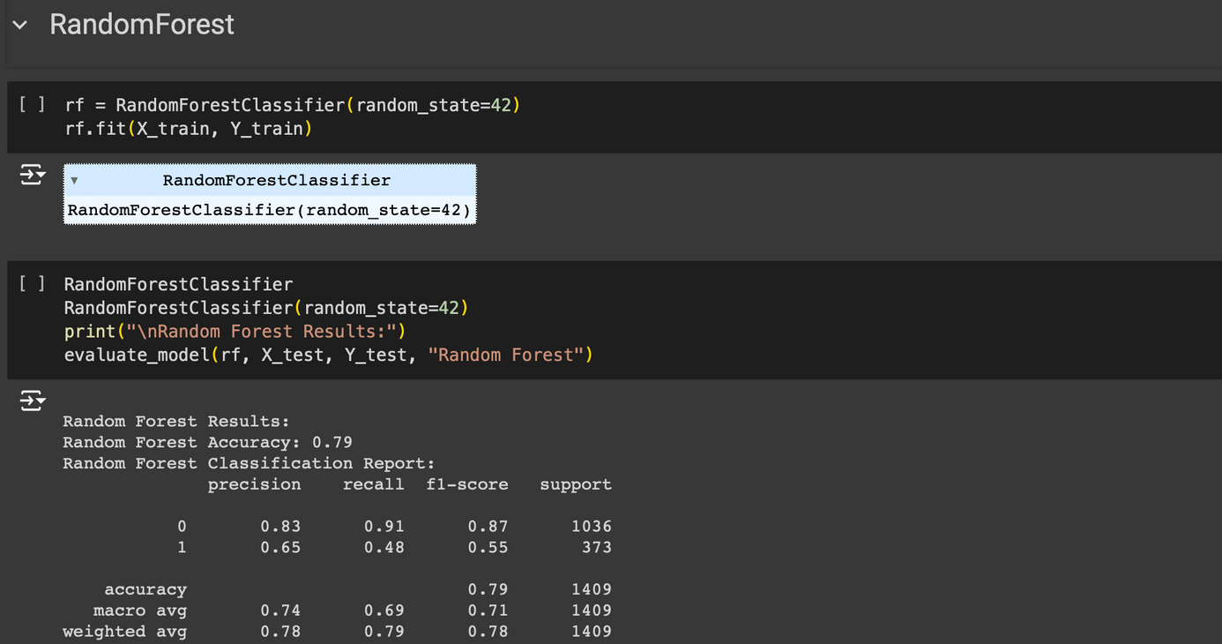
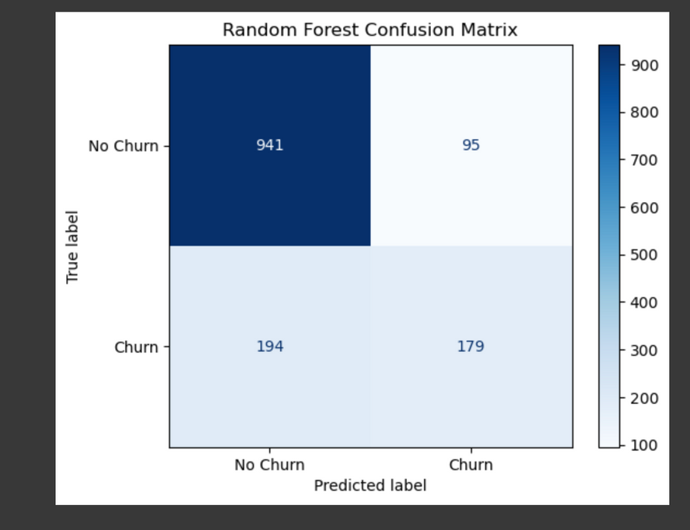
RANDOM FOREST

Slide 25
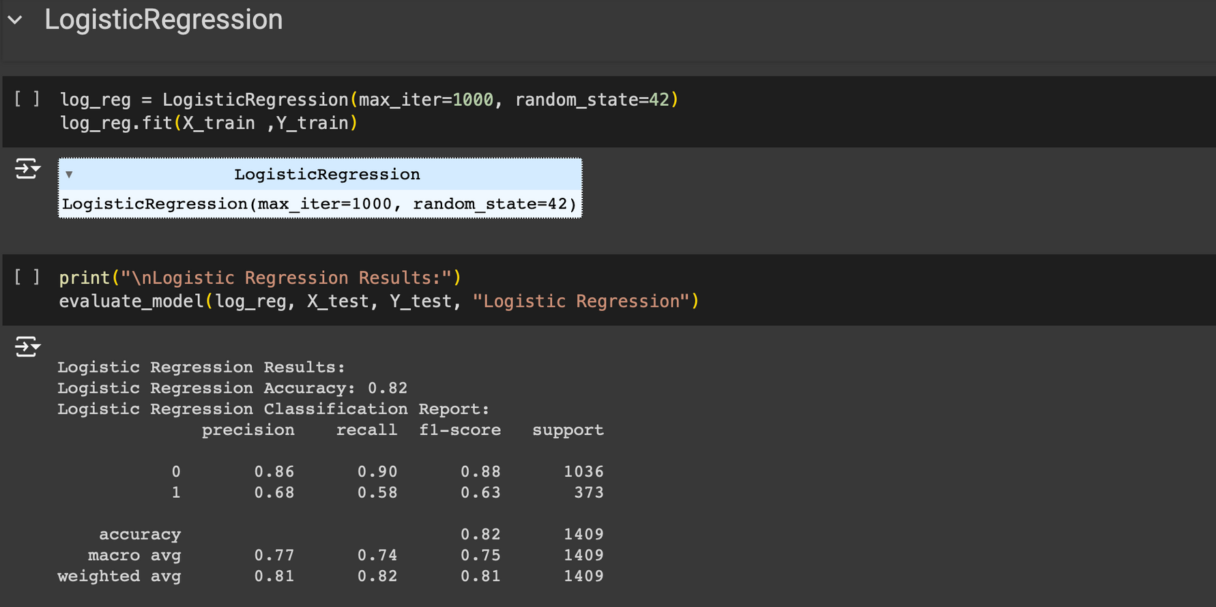

LOGISTIC REGRESSION

Slide 26
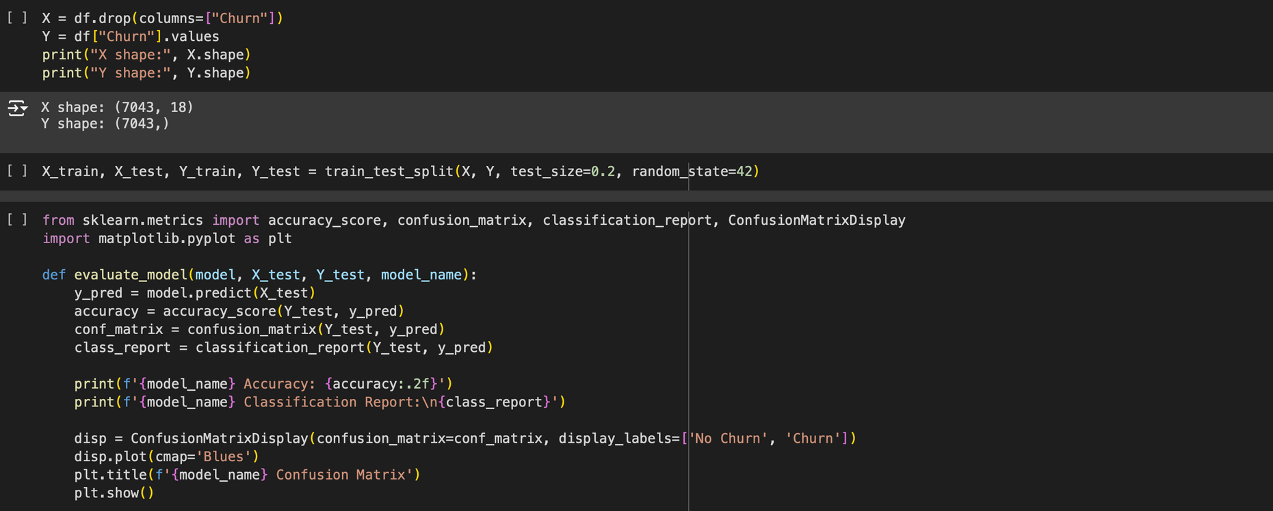
CLASSIFICATION MODEL

Slide 27
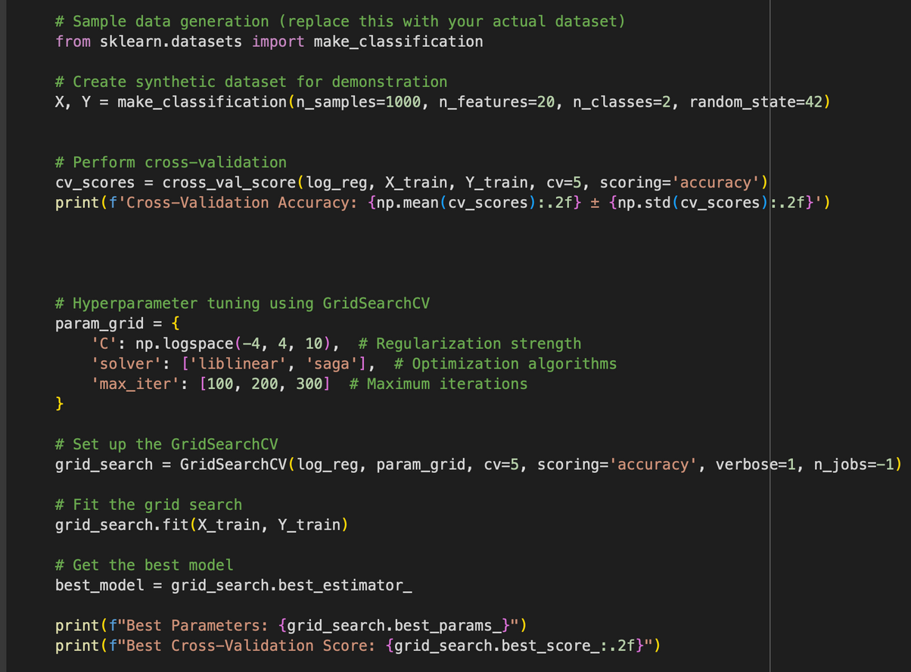
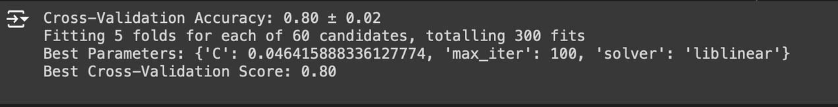
OPTIMISATION

Slide 28
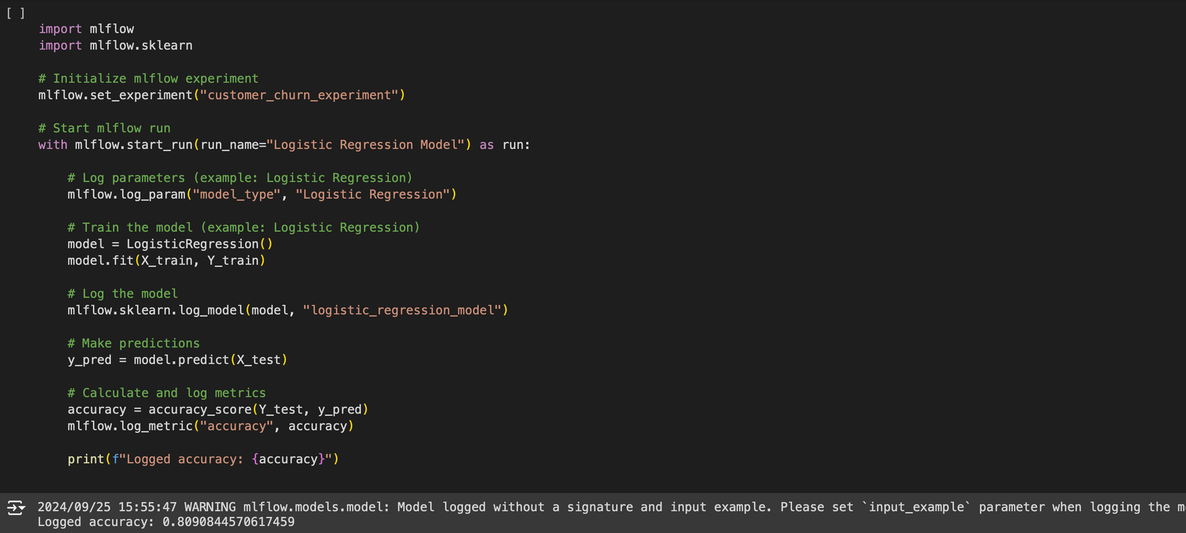
OPTIMISATION

Slide 29
5- ASSUMPTION AND RESULTS

Slide 30

churn analysis proved that most chured customers are the new customers so our recommendation for the company is to apply catching offers and to increse the one year contract

Slide 31
churn analysis proved that althpugh not many customers churned many of the one month contreact churned , our recommendation are to apply a gift or vouchers to theese customers on the one yer customers

Slide 32
churn analysis proved that many customers that are tenure high ddont churn so they must have some privilage and gifts to keep them

Slide 33
THANKS ALOT
any questions ??

